Slide 1
WeavCanvas
Team: TrojanX
Members: Ananya Sajwan & Soumyadeepta Das

Slide 2
Overview
Designers and Painters are turning to digital tools for their work, and require collaboration and file management without any compromise on the performance of their work.
Our project WeavCanvas allows artists and designers to seamlessly create stunning paintings and geometrical designs, using our AI canvas and unique brushes.
They can collaborate with others in real time even from different devices, as our projects will be using websockets from socket.io.

Slide 3
Overview
The project will also allow speech to text and text to speech messaging as they dont wanna type while doing the art, and save it as png.
We will be integrating Weavy File browser, so that they can it allows easy management of files and picking required files from their canvas without moving over to any other place.

Slide 4
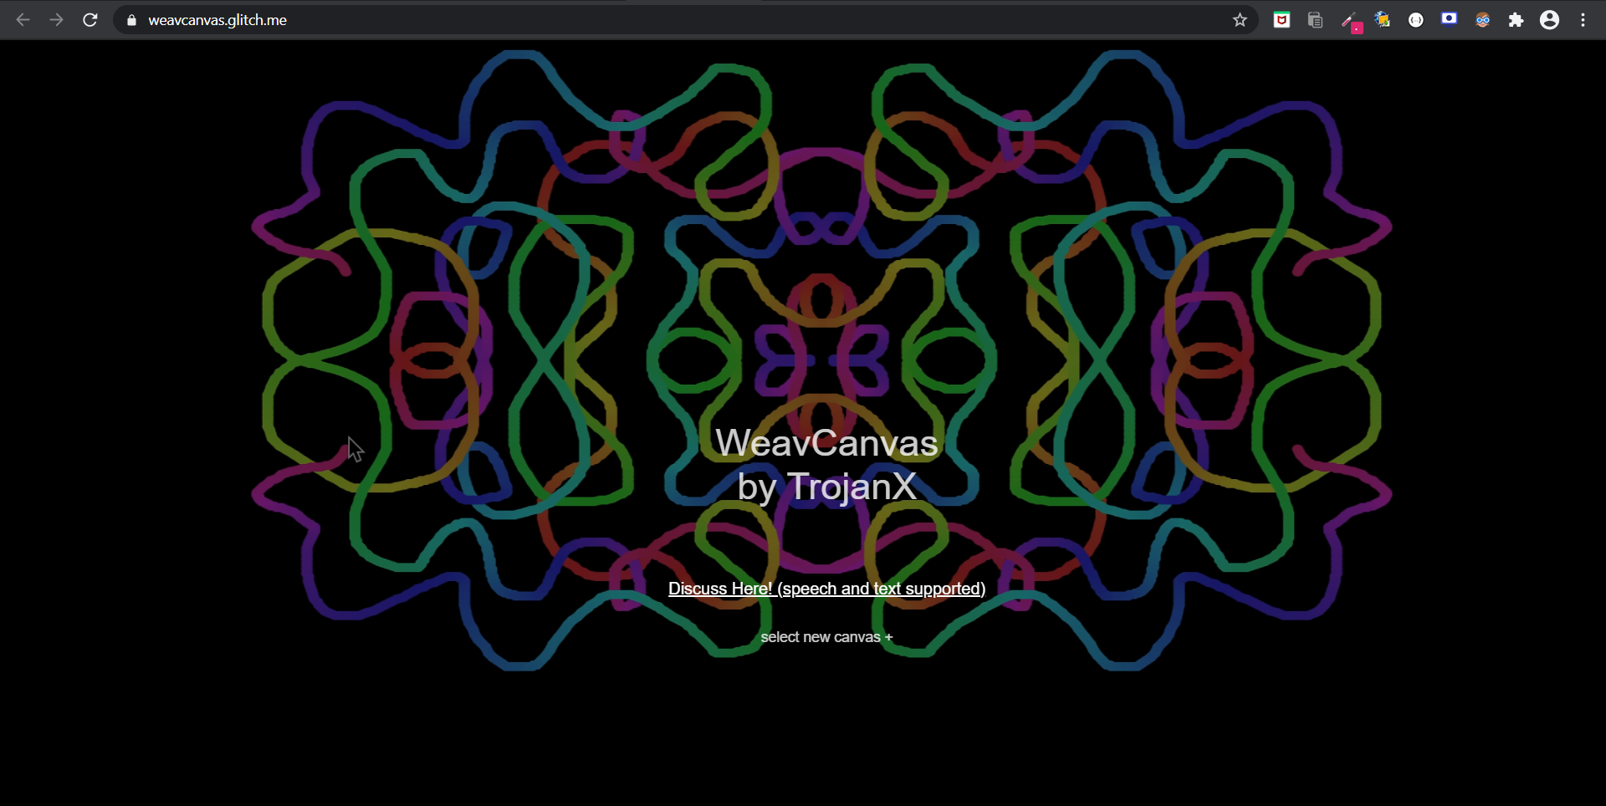
Home Screen

Slide 5
Process Flow
Setup of Canvas
Open the same socket io enabled Canvas on multiple computers to start collaborating
Design
Design collaboratively
Finalize
Save the work
Discuss using Text or speech without moving out from the canvas
Or refresh
Use and share required files using Weavy file picker
Or switch to new design theme
All at one place

Slide 6
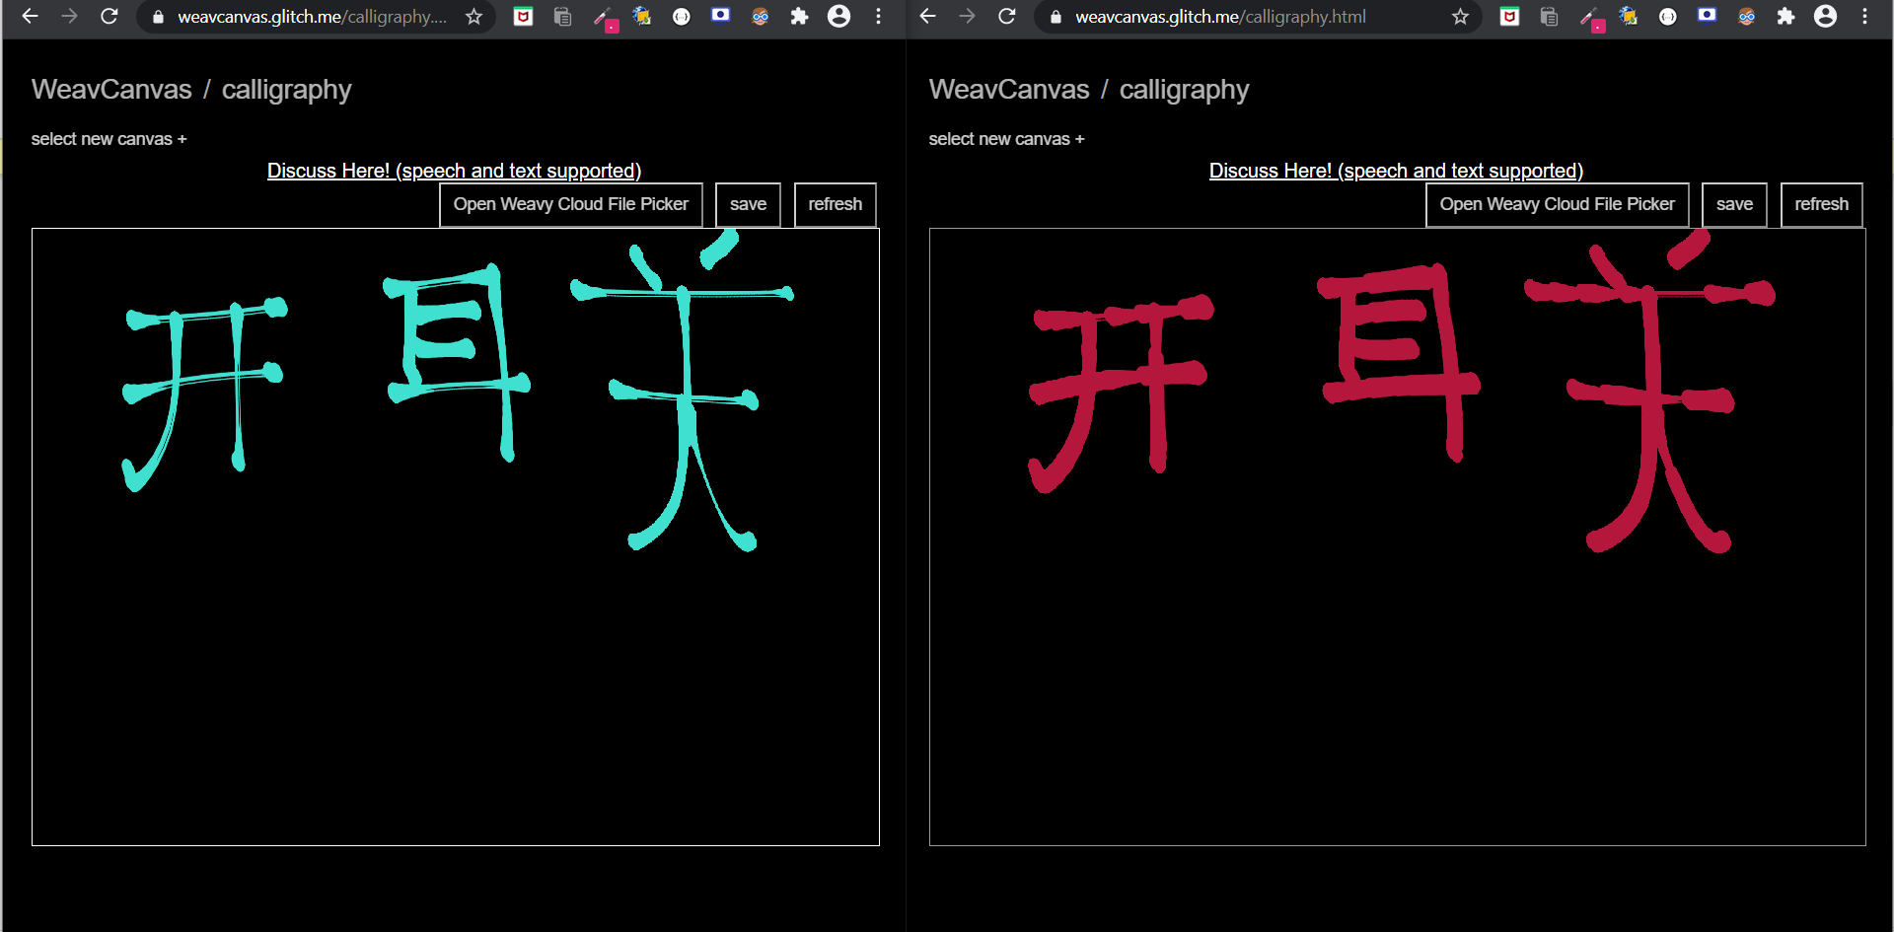
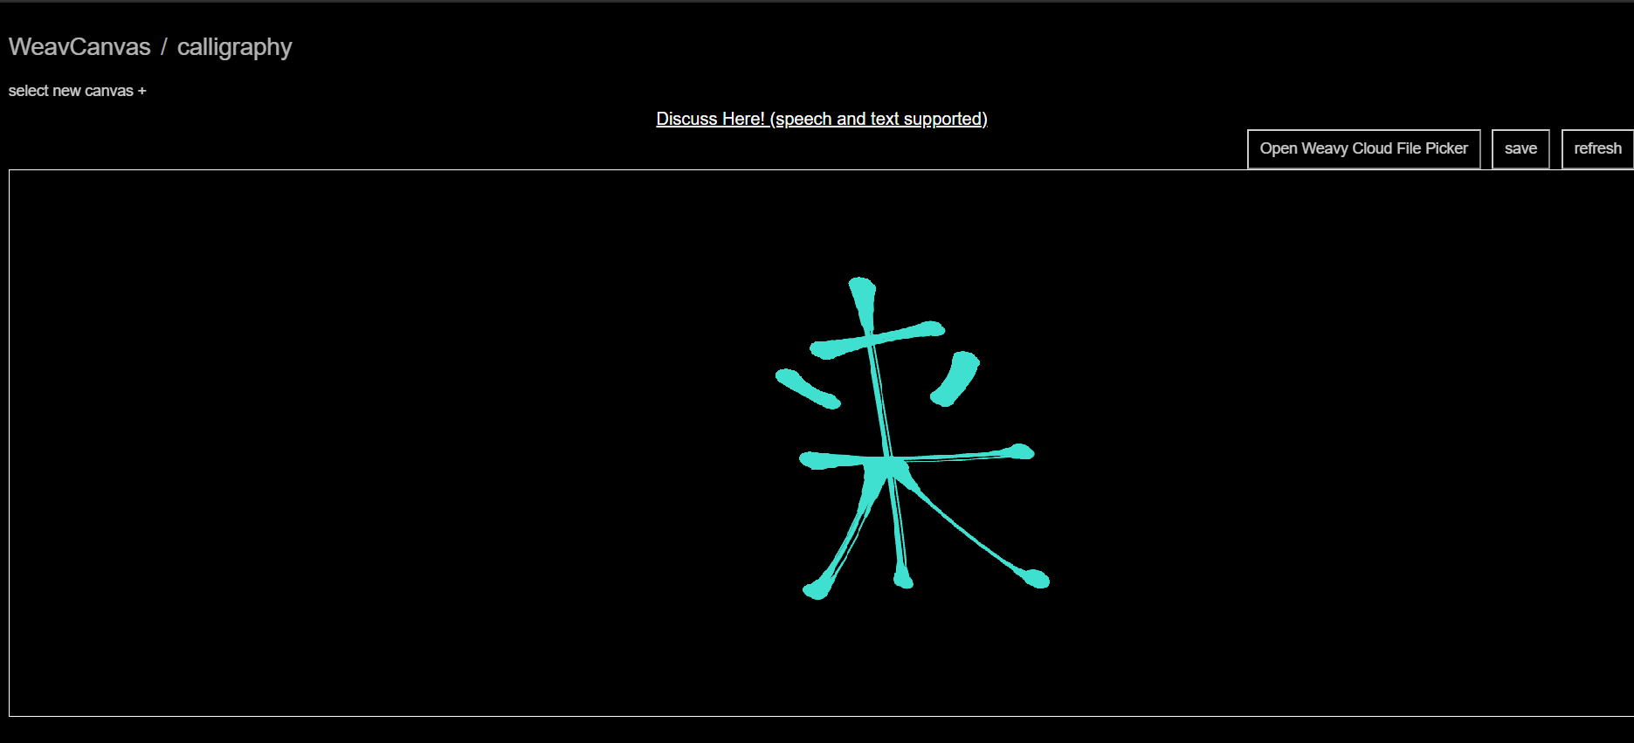
WeavCanvas will have 2 types of Canvas and Brushes:
1) Calligraphy and artist canvas with different brushes:

Slide 7
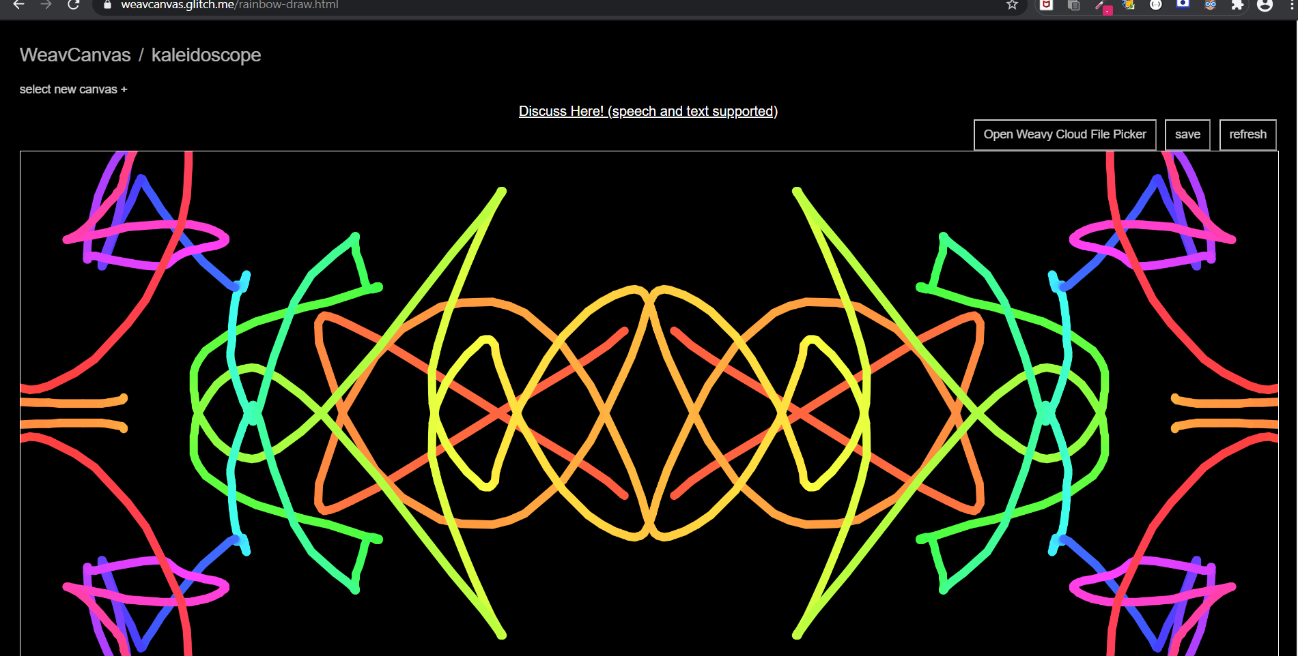
WeavCanvas will have 2 types of Canvas and Brushes:
2) Kaleidoscope canvas which will allow creation of Symmetric and geometric designs with minimal or no skill.

Slide 8
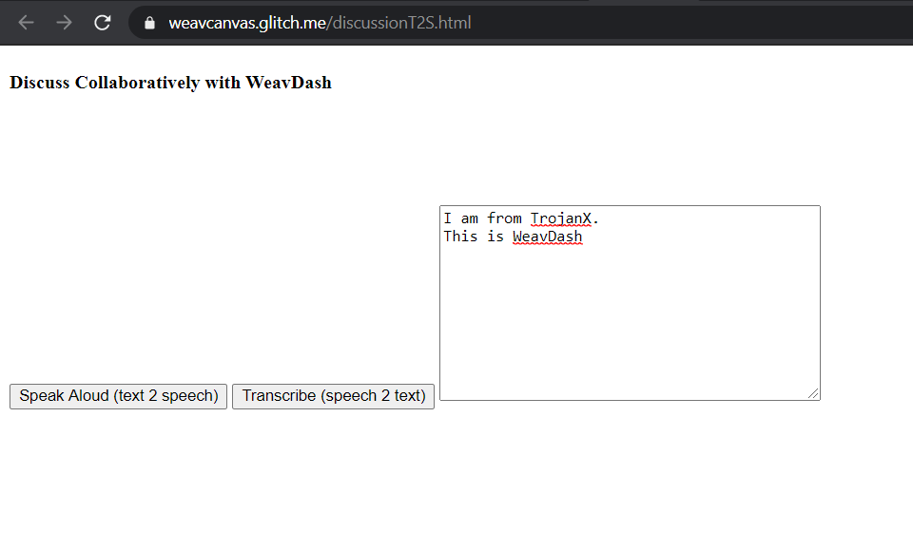
Speech to Text and Vice Versa
The discuss button allows the users to discuss using speech to text and text to speech, seamlessly working collaboratively as well as documenting.

Slide 9
Impact
This project adds to :
1) Realtime Collaboration
2) Design AI
3) Easy communication while doing the work, instaed of context switching
4) Easy file management
5) All in one experience

Slide 10
Technology Stack
1) NodeJs
2) sockets
3) p5.js
4) Weavy file browser
5) Webkit Speech Recognizer
6) Text2Speech
7) Express

Slide 11
Thank You

